Slide 1
Unit Testing Vue Apps:
Tips, Tricks, and Best Practices
Akash Das

Slide 2
Intro
Why Unit Test
What to Test
Inputs vs. Outputs
What Not to Test
How to Write Tests
Scaffolding
Tools
Real Tests (+Utilities, +Mocks)
Notes:
The first half of this talk will be agnostic to your tools
In the second half, we’ll dive into the tools we’ve chosen at Lob: Vitest, Vue Test Utils, and Testing Library

Slide 3




Why unit test?
Document behavior
Verify requirements
Provide a safety net
Write better code
What is the expected behavior?
Does the thing do what it’s expected to do?
Makes it less risky/easier to refactor
Is your code too hard to test?
Notes:
Document behavior
Have you ever looked at a chunk of code and wondered, what the heck is this supposed to be doing?
Can refer to the tests to figure what is supposed to happen
Verify requirements
Ok, we now know what it’s supposed to do
Does it actually do what it’s supposed to do?
Provides a safety net
If you’re rewriting or refactoring a function or a component, you should hypothetically not need to edit or change the tests at all and they should still pass if you’re going for parity with previous behavior
Quick feedback if you’ve broken something
Write better code
Is your code too hard to test?
Is your code too complex?
Does your code violate the single responsibility principle?
Should it be broken down?

Slide 4
Intro
Why Unit Test
What to Test
Inputs vs. Outputs
What Not to Test
How to Write Tests
Scaffolding
Tools
Real Tests (+Utilities, +Mocks)
Notes:
A common question I hear a lot is, what am I supposed to test in a browser?

Slide 5
What should I be writing unit tests for?
Inputs What are things a user can see/do?
Outputs What are the results of what the user can do?
Notes:
At first, this seems a bit more nebulous than something like an API
For an API, you get some parameters, you need to make something happen, and you end up with a final response to the browser
We’ll go through actual examples of what this means in a bit

Slide 6



Things to not test, though you may be tempted to
API Return Values
External Libraries
Implementation Details
If you control your API, it should have its own tests.
If you don’t control your API … it should have its own tests.
Axios, components from a UI component library, lodash, etc.
If a user takes x action, prop/data field y changes.
Instead, what should the user see/do?
Notes:
The tl;dr here honestly is select APIs and third-party libraries that are well-tested in and of themselves

Slide 7
What should I be writing unit tests for?
No
Instead…
When the user types a name, the component’s data field updates
When the user types a name, the text input shows the name they typed
When the user submits the form, an API call is made with the name as a param

Slide 8
What should I be writing unit tests for?
No
Instead…
A user opens a form, a modal pops up, they input a name, they click submit, and get taken to a different page
A modal renders with an input for name
A button to submit exists
When the button is clicked, the API is called
When the button is clicked, the modal closes
Notes:
That’s what integration tests are for!
(you are writing integration tests, right?)
Hard to figure out what part fails

Slide 9
Intro
Why Unit Test
What to Test
Inputs vs. Outputs
What Not to Test
How to Write Tests
Scaffolding
Tools
Real Tests (+Utilities, +Mocks)

Slide 10
Demo!
Notes:
I’ve created a demo app, which is a fairly stripped down version of Lob’s customer Dashboard and instead of our API, I used a dog API (because why not).
App uses Vue 3, Vite, Pinia, and TailwindCSS

Slide 11
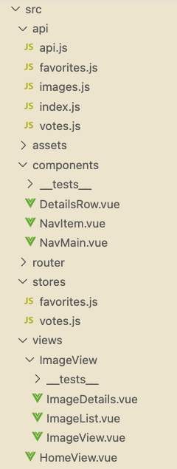
App structure
Notes:
API modules for each group of endpoints that our application uses
Components
DetailsRow - breed, favorite buttons, vote buttons on Details page
Favorite and vote stores
Views
Home
ImageView - container with heading
ImageList - list of dogs and pagination
ImageDetails - one dog with large picture, card with breed/favorite/vote information

Slide 12
Scaffolding
Write all describe/it blocks based on user behavior
Use describe blocks for various conditions
Use it blocks to demonstrate expectations under each condition
I like to do this before writing a single, full test
@akash-coded akash-coded.com

Slide 13
NavItem
@akash-coded // akash-coded.com

Slide 14
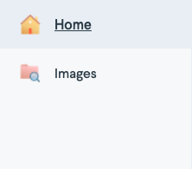
NavItem
@akash-coded // akash-coded.com

Slide 15
NavItem
describe('NavItem', () => { it('renders an icon', () => {}); it('renders a title', () => {}); describe('when active', () => { it('is underlined and has a darker background', () => {}); });
describe('when not active', () => { it('is not underlined and has the same background as the MainNav', () => {}); }); });
@akash-coded // akash-coded.com

Slide 16
ImageList
@akash-coded // akash-coded.com

Slide 17
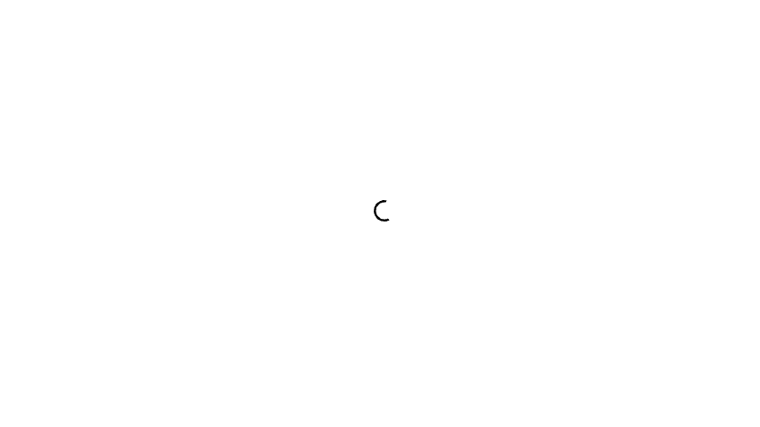
ImageList - loading state
@akash-coded // akash-coded.com

Slide 18
ImageList - loading state
describe('before data has loaded', () => { it('renders a loading indicator', () => {}); });
@akash-coded // akash-coded.com

Slide 19
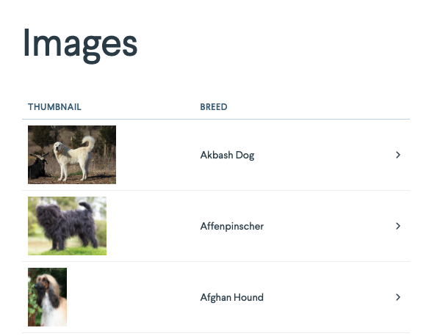
ImageList - table
@akash-coded // akash-coded.com

Slide 20
ImageList - table rows
describe('when data has been loaded successfully', () => {
describe('table row', () => { it('renders one for each dog returned from the API and the header row', () => {}); it('renders an image', () => {}); describe('if there are breeds', () => { it('renders the breeds', () => {}); });
describe('if there are no breeds', () => { it('renders \'Unknown\'', () => {}); }); describe('when clicked', () => { it('goes to the details page', () => {}); }); });
...
});
@akash-coded // akash-coded.com
Notes:
When a row is clicked, we don’t really care what’s on the details page in this unit test, we just care that it goes to it

Slide 21
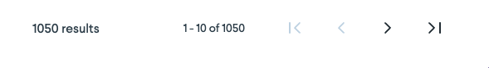
ImageList - pagination
@akash-coded // akash-coded.com
Notes:
External component from Lob’s UI component library
Has its own tests to make sure it shows/does all the things it’s supposed to show/do
Our tests are going to be lighter

Slide 22
ImageList - pagination
describe('when data has been loaded successfully', () => {
... describe('pagination', () => { it('renders', () => {});
describe('when next page is clicked', () => { it('changes the URL to the next page', () => {}); it('calls the API to fetch the next page of data', () => {}); });
describe('when previous page is clicked', () => { it('changes the URL to the previous page', () => {}); it('calls the API to fetch the previous page of data', () => {}); }); });
});
@akash-coded // akash-coded.com
Notes:
We’re not testing if on the last page, the next arrow is disabled
That should be in the pagination component’s unit tests
The current page is controlled in the component state
Instead of checking though that the state value is the page number we’d expect, we’re testing what a user would actually see in their browser

Slide 23
ImageList - error state
describe('when there was an error loading data', () => { it('renders an error alert', () => {}); });
@akash-coded // akash-coded.com

Slide 24
ImageDetails
@akash-coded // akash-coded.com

Slide 25
ImageDetails - loading state
@akash-coded // akash-coded.com

Slide 26
ImageDetails - loading state
describe('before data has loaded', () => { it('renders a loading indicator', () => {}); });
@akash-coded // akash-coded.com

Slide 27
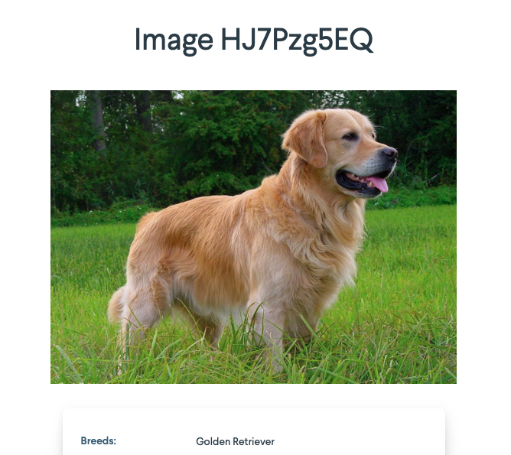
ImageDetails - header, image, breed
@akash-coded // akash-coded.com

Slide 28
ImageDetails - header, image, breed
describe('when data has been loaded successfully', () => { it('renders a heading with the image ID', () => {}); it('renders the image', () => {}); describe('if there are breeds', () => { it('renders the breeds', () => {}); }); describe('if there are no breeds', () => { it('renders \'Unknown\'', () => {}); });
...
});
@akash-coded // akash-coded.com

Slide 29
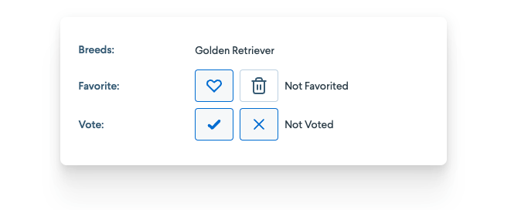
ImageDetails - favorite section
@akash-coded // akash-coded.com

Slide 30
describe('favorite section', () => { it('renders a favorite button', () => {}); it('renders a delete favorite button', () => {}); describe('if the image hasn\'t been favorited', () => { it('should show \'Not Favorited\'', () => {}); it('favorite button should not be red', () => {}); it('delete favorite button should be disabled', () => {}); describe('clicking the favorite button', () => { it('should call the API to favorite the image', () => {}); }); }); describe('if the image has been favorited', () => { it('should show \'Favorited\'', () => {}); it('favorite button should be red', () => {}); it('delete favorite button should be enabled', () => {}); describe('clicking the delete button', () => { it('should call the API to delete the favorite', () => {}); }); }); });
@akash-coded // akash-coded.com

Slide 31
ImageDetails - vote section
@akash-coded // akash-coded.com

Slide 32
describe('vote section', () => { it('renders upvote and downvote buttons', () => {}); describe('if the image hasn\'t been voted on', () => { it('should show \'Not Voted\'', () => {}); it('upvote button should not be green', () => {}); it('downvote button should not be yellow, () => {}); }); describe('if the image has been upvoted', () => { it('should show \'Upvoted\'', () => {}); it('upvote button should be green', () => {}); }); describe('if the image has been downvoted', () => { it('should show \'Downvoted\'', () => {}); it('downvote button should be yellow, () => {}); }); describe('clicking the upvote button', () => { it('should call the API to upvote the image', () => {}); }); describe('clicking the downvote button', () => { it('should call the API to downvote the image', () => {}); }); });
@akash-coded // akash-coded.com

Slide 33
ImageDetails - error state
describe('when there was an error loading data', () => { it('renders an error alert', () => {}); });
@akash-coded // akash-coded.com
Notes:
Same as the List

Slide 34
Intro
Why Unit Test
What to Test
Inputs vs. Outputs
What Not to Test
How to Write Tests
Scaffolding
Tools
Real Tests (+Utilities, +Mocks)
@akash-coded // akash-coded.com
Notes:
Now that we’ve got our tests outlined, how do we actually fill them in?
For that, we’ll utilize a few tools…

Slide 35



Tools
Vitest
Vue Test Utils
Testing Library
Test runner
Same API as Jest
Test coverage
jsdom for DOM mocking
Fast watch mode
mount function
Provides wrapper utility methods
Testing Library’s render method based off this mount
DOM testing library specifically for UIs
getBy, queryBy, findBy selectors
fireEvent/userEvent
jest-dom matchers
Vue version uses Vue Test Utils under the hood
@akash-coded // akash-coded.com
Notes:
Testing Library and Vue Test Utils play well together and are very easy to use together

Slide 36
mount/render
Vue Test Utils provides a mount function that returns a wrapper
When Googling around for Vue unit testing, you’ll most likely see some version of this
Testing Library’s render is built off of the mount function
render returns some wrapper utility methods but not all
So why use it?
Supports mocking the store, router, plugins, packages
Returns an object that can be destructured to access utility functions for querying for elements
@akash-coded // akash-coded.com

Slide 37
wrapper
it('button click should increment the count', () => { expect(wrapper.vm.count).toBe(0) const button = wrapper.find('button') button.trigger('click') expect(wrapper.vm.count).toBe(1) });
@akash-coded // akash-coded.com

Slide 38
Testing Library selectors
getBy/getAllBy
queryBy/queryAllBy
findBy/findAllBy
Returns a matching node(s)
Throws an error if no elements match
Returns a matching node(s)
Returns null if no elements match
Returns a promise which resolves when an element is found which matches the given query. The promise is rejected if no element is found after a default timeout of 1000ms.
@akash-coded // akash-coded.com
Notes:
queryBy
If you’re asserting that something doesn’t exist in the DOM, you’ll want to use queryBy because getBy will throw an error
findBy
If you’re wanting to select something that only exists after, for example, an API call is made, you’ll want to use findBy

Slide 39
fireEvent vs. userEvent
Both are ways of interacting with your UI through unit tests
fireEvent
Built into Testing Library
Dispatch exactly the events you tell it to, even if those events can’t be dispatched in a real browser interaction
userEvent
Built on top of fireEvent
Attempts to more realistically simulate user interactions
@akash-coded // akash-coded.com
Notes:
fireEvent will still dispatch an event if your element is disabled, hidden, etc.
userEvent WILL NOT work in this situations
Sometimes I find myself wondering why userEvent.click isn’t working, and for kicks and giggles replace it with fireEvent and it does. That usually tips me off that my element is un-interactable in some way.

Slide 40
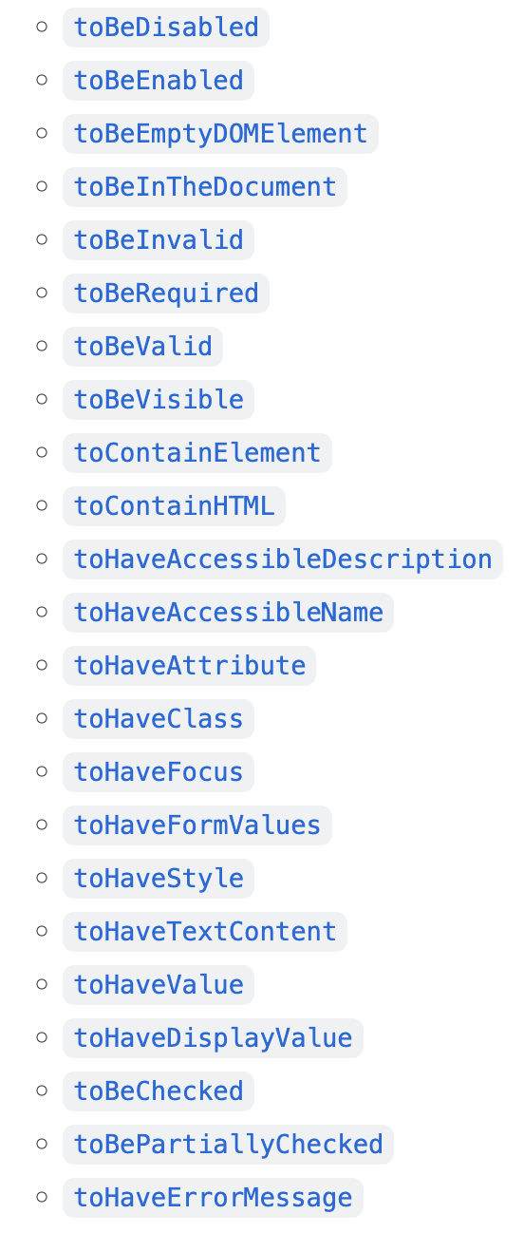
jest-dom
Companion library for Testing Library that provides a variety of custom DOM element matchers
@akash-coded // akash-coded.com

Slide 41
Intro
Why Unit Test
What to Test
Inputs vs. Outputs
What Not to Test
How to Write Tests
Scaffolding
Tools
Real Tests (+Utilities, +Mocks)
@akash-coded // akash-coded.com
Notes:
For the sake of time, we’re going to focus on cherry picked tests from ImageDetails and ImageList components specifically
They provide a variety of things you may encounter
Mocking the router
Mocking API and making API calls
Buttons disabled/enabled

Slide 42
ImageDetails
@akash-coded // akash-coded.com
Notes:
The ImageDetails are a bit more UI heavy, so we’ll focus on those first

Slide 43
Setting up
import '@testing-library/jest-dom'; import { createTestingPinia } from '@pinia/testing';
vi.mock('vue-router', () => ({ useRoute: () => ({ params: { id: 'HJ7Pzg5EQ' } }), })); const store = createTestingPinia({ initialState: { favorites: [], votes: [] } });
@akash-coded // akash-coded.com
Notes:
Mocking the router
We only need `useRoute` here, but if we needed `useRouter` as well for something like `router.push`, we’d have to mock that too
Mocking the store with default empty arrays

Slide 44
Setting up
const mockImageReturn = { data: { id: 'HJ7Pzg5EQ', url: 'https://cdn2.thedogapi.com/images/HJ7Pzg5EQ_1280.jpg', breeds: [{ name: 'Golden Retriever' }] } }; const mockFavoritesReturn = [{ id: 41298, user_id: 'i8sceq', image_id: 'HJ7Pzg5EQ', sub_id: null, created_at: '2022-06-06T15:36:05.000Z', image: { id: 'HJ7Pzg5EQ', url: 'https://cdn2.thedogapi.com/images/HJ7Pzg5EQ.jpg' } }];
@akash-coded // akash-coded.com
Notes:
Mocking API returns
Based off actual API return values (and by that I mean, copied and pasted from)
Serves as further documentation if someone wanted to see what an API return from an endpoint would look like but don’t want to open Postman or go digging around the Network tab

Slide 45
Setting up
const mockVotesUpvoteReturn = [{ id: 100517, image_id: 'HJ7Pzg5EQ', sub_id: null, created_at: '2022-06-06T15:39:34.000Z', value: 1, country_code: 'US' }]; const mockVotesDownvoteReturn = [{ id: 100517, image_id: 'HJ7Pzg5EQ', sub_id: null, created_at: '2022-06-06T15:39:34.000Z', value: 0, country_code: 'US' }];
@akash-coded // akash-coded.com

Slide 46
Setting up
import ImageDetails from '../ImageDetails.vue';
import { render } from '@/utils';
const renderComponent = (options = {}) => render( ImageDetails, { global: { plugins: [store] }, ...options } );
@akash-coded // akash-coded.com
Notes:
Then we have something that looks like this, which is kind of a strange-looking line

Slide 47
RenderComponent utility
Globals in our application:
Custom UI component library
Internationalization
Constants plugin
Dates plugin
Number formatting plugin
Segment for analytics tracking
...and more
@akash-coded // akash-coded.com
Notes:
It would be annoying to have to pull each of these into every one of our test files

Slide 48
RenderComponent utility
import { render as VTLRender } from '@testing-library/vue';
export const render = (Component, options = {}) => { const { global = {}, ...otherOptions } = options; const { plugins = [], mocks = {}, ...otherGlobalOptions } = global; return VTLRender(Component, { global: { plugins: [components, i18n, constants, $dates, $format, ...plugins], mocks: { ...mocks, $segment }, ...otherGlobalOptions }, ...otherOptions }); };
@akash-coded // akash-coded.com
Notes:
We created a utility method to wrap all of the things we use in the render function to be available to tests
Built on top of Testing Library’s render

Slide 49
Setting up
import ImageDetails from '../ImageDetails.vue';
import { render } from '@/utils';
const renderComponent = (options = {}) => render( ImageDetails, { global: { plugins: [store] }, ...options } );
@akash-coded // akash-coded.com

Slide 50
beforeEach + loading state
describe('ImageDetails', () => { beforeEach(() => { vi.spyOn(imagesApi, 'findById').mockResolvedValue(mockImageReturn); }); describe('before data has loaded', () => { it('renders a loading indicator', () => { const { getByTestId } = renderComponent(); const loading = getByTestId('loading-indicator'); expect(loading).toHaveAttribute('aria-busy', 'true'); }); });
...
});
@akash-coded // akash-coded.com
Notes:
Mocking the API request to get a single image since we can’t and don’t want to fire off an actual API call
Able to use `getBy` query here because this happens immediately when the DOM is loaded

Slide 51
When data has loaded
describe('when data has been loaded successfully', () => { it('renders a heading with the image ID', async () => { const { findByRole } = renderComponent(); const heading = await findByRole('heading', { name: `Image ${mockImageReturn.data.id}` }); expect(heading).toBeInTheDocument(); });
it('renders the image', async () => { const { findByRole } = renderComponent(); const image = await findByRole('img'); expect(image).toHaveAttribute('src', mockImageReturn.data.url); });
...
});
@akash-coded // akash-coded.com
Notes:
Using `findBy` here because of the initial API call takes time to resolve, and thus these elements don’t exist on the DOM when the component first renders

Slide 52
Favorite section - if the image hasn’t been favorited
describe('if the image hasn\'t been favorited', () => {
it('should show \'Not Favorited\'', async () => { const { findByText } = renderComponent(); const notFavoritedText = await findByText('Not Favorited'); expect(notFavoritedText).toBeInTheDocument(); });
it('favorite button should not be red', async () => { const { findByRole } = renderComponent(); const favoriteButton = await findByRole('button', { name: 'Favorite' }); expect(favoriteButton).not.toHaveClass('!border-coral-700 !bg-coral-700'); });
it('delete favorite button should be disabled', async () => { const { findByRole } = renderComponent(); const deleteFavoriteButton = await findByRole('button', { name: 'Delete Favorite' }); expect(deleteFavoriteButton).toBeDisabled(); });
...
});
@akash-coded // akash-coded.com

Slide 53
Favorite section - if the image hasn’t been favorited
describe('clicking the favorite button', () => { it('should call the API to favorite the image', async () => { vi.spyOn(favoritesApi, 'favorite').mockResolvedValue({ success: true }); vi.spyOn(favoritesApi, 'findAll').mockResolvedValue(mockFavoritesReturn); const { findByRole } = renderComponent(); const favoriteButton = await findByRole('button', { name: 'Favorite' }); await userEvent.click(favoriteButton); expect(favoritesApi.favorite).toHaveBeenCalledWith({ image_id: mockImageReturn.data.id }); }); });
@akash-coded // akash-coded.com

Slide 54
ImageList
@akash-coded // akash-coded.com
Notes:
The ImageList is a bit more API-heavy

Slide 55
ImageList
@akash-coded // akash-coded.com

Slide 56
Setting up
const pushMock = vi.fn(); vi.mock('vue-router', () => ({ useRoute: () => ({ path: '/images', query: {} }), useRouter: () => ({ push: pushMock }) }));
@akash-coded // akash-coded.com
Notes:
The setup for this file is very similar to the ImageDetails component, except that we need a little more from our router mock this time
We need a query object and a router.push

Slide 57
Setting up
const mockImagesReturn = { data: [{ id: 'B1-llgq4m', url: 'https://cdn2.thedogapi.com/images/B1-llgq4m_1280.jpg', breeds: [{ name: 'Australian Shepherd' }] }, { id: 'HJ7Pzg5EQ', url: 'https://cdn2.thedogapi.com/images/HJ7Pzg5EQ_1280.jpg', breeds: [{ name: 'Golden Retriever' }] }, { id: 'AwKd_0wL4', url: 'https://cdn2.thedogapi.com/images/AwKd_0wL4.jpg' }], count: 3 };
@akash-coded // akash-coded.com
Notes:
We also need a mock API return that’s more representative of what we’d get back from the findAll endpoint

Slide 58
Table row - renders per dog + header
describe('when data has been loaded successfully', () => {
describe('table row', () => { beforeEach(() => { vi.spyOn(imagesApi, 'findAll').mockResolvedValue(mockImagesReturn); }); it('renders one for each dog returned from the API and the header row', async () => { const { findAllByRole } = renderComponent(); const rows = await findAllByRole('row'); expect(rows.length).toEqual(mockImagesReturn.data.length + 1); });
... });
});
@akash-coded // akash-coded.com

Slide 59
Table row - when clicked
describe('table row', () => { ... describe('when clicked', () => { it('goes to the details page', async () => { const { findByTestId } = renderComponent(); const row = await findByTestId(`row-${mockImagesReturn.data[0].id}`); await userEvent.click(row); expect(pushMock).toHaveBeenLastCalledWith(`/images/${mockImagesReturn.data[0].id}`); }); }); });
@akash-coded // akash-coded.com
Notes:
We don’t care what’s on the details page, just that it goes to it
What’s there should be tested in the ImageDetails component and integration/E2E tests

Slide 60
Pagination function
async function handlePageChange ({ page }) { state.loading = true; state.currentPage = page; try { if (state.currentPage === 1) { router.push(`${route.path}`); } else { router.push(`${route.path}?page=${state.currentPage}`); } const response = await imagesApi.findAll({
...INITIAL_PARAMS,
page: state.currentPage - 1
}); state.images = response.data; } catch (err) { state.error = err.message; } finally { state.loading = false; } }
@akash-coded // akash-coded.com
Notes:
Here’s what the handlePageChange function looks like
Takes a page number
Pushes new URL depending on page
Calls the API for the new page data

Slide 61
Pagination
describe('pagination', () => { const mockReturn = { data: Array.from({ length: 11 }).map(() => mockImagesReturn.data[0]), count: 11 };
...
});
@akash-coded // akash-coded.com
Notes:
Our paging is set to 10 dogs per page, so in order to fake having multiple pages, we’re taking the first dog in our mock return and creating an array of 11 of them

Slide 62
Pagination - when next page is clicked
describe('when next page is clicked', () => { beforeEach(async () => { vi.spyOn(imagesApi, 'findAll').mockResolvedValue(mockReturn); }); it('changes the URL to the next page', async () => { const { findByRole } = renderComponent(); const nextButton = await findByRole('button', { name: 'Go to next page' }); await userEvent.click(nextButton); expect(pushMock).toHaveBeenLastCalledWith('/images?page=2'); }); ... });
@akash-coded // akash-coded.com

Slide 63
Pagination - when next page is clicked
describe('when next page is clicked', () => { beforeEach(async () => { vi.spyOn(imagesApi, 'findAll').mockResolvedValue(mockReturn); }); ... it('calls the API to fetch the next page of data', async () => { const { findByRole } = renderComponent(); const nextButton = await findByRole('button', { name: 'Go to next page' }); await userEvent.click(nextButton); // API is zero-based, so need to subtract one from the page expect(imagesApi.findAll).toHaveBeenLastCalledWith(expect.objectContaining({ page: 1 })); }); });
@akash-coded // akash-coded.com

Slide 64
+ so much more!
@akash-coded // akash-coded.com
Notes:
There are going to be other situations you’ll need to test that we haven’t covered, but I hope this gives you a good start!

Slide 65
Where to find all of the things
Slides: https://tinyurl.com/vueconf-unit-testing
Demo app (deployed): https://vueconf-2022-demo-app.vercel.app/
Demo app (code): https://github.com/akash-coded/vueconf-2022-demo-app
Me:
Twitter: @akash-coded
GitHub: @akash-coded
LinkedIn: https://www.linkedin.com/in/akash-coded08/
(out-of-date) Website: akash-coded.com
@akash-coded // akash-coded.com

Slide 66
Thank you!
@akash-coded // akash-coded.com

Slide 67
Questions?
@akash-coded // akash-coded.com
Notes:
Looks like we’re out of time for questions, but please find me or reach out to me on the interwebs if you do have them!

Slide 68
Appendix
aka the stuff I didn’t have time for
@akash-coded // akash-coded.com

Slide 69
findByBrokenText utility
<span> You should pay attention to everything, but you <span class="font-bold"> really </span> should pay attention to this. </span>
@akash-coded // akash-coded.com
Notes:
Let’s say you have text that looks like this, where it’s broken up slightly
If you tried to find by text on the full sentence, your test will fail because it can’t find a singular element with the entire text
So you have two options:
You can search for each constituent part (but what happens if they get out of order in your code?)
You can create a utility function that will search for the full thing

Slide 70
findByBrokenText utility
export async function findByBrokenText (text) { return screen.findByText((_content, node) => { const hasText = (node) => node.textContent === text; const nodeHasText = hasText(node); const childrenDontHaveText = Array.from(node.children).every((child) => !hasText(child)); return nodeHasText && childrenDontHaveText; }); }
Source: https://polvara.me/posts/five-things-you-didnt-know-about-testing-library
@akash-coded // akash-coded.com

Slide 71
Favorite section - if the image has been favorited
describe('if the image has been favorited', () => {
...
describe('clicking the delete button', () => { it('should call the API to delete the favorite', async () => { vi.spyOn(favoritesApi, 'delete').mockResolvedValue({ success: true }); vi.spyOn(favoritesApi, 'findAll').mockResolvedValue([]); const { findByRole } = renderComponent(); const deleteFavoriteButton = await findByRole('button', { name: 'Delete Favorite' }); await userEvent.click(deleteFavoriteButton);
expect(favoritesApi.delete).toHaveBeenCalledWith(mockFavoritesReturn[0].id); }); });
});
@akash-coded // akash-coded.com

